Slide 1

Disorderly programming.
CALM analysis.

Slide 2
The future is already here
Nearly all nontrivial systems are (or are becoming) distributed
Programming distributed systems is hard
Reasoning about them is harder

Slide 3
Outline
Disorderly Programming
The Bloom programming language
CALM Analysis and visualization
Challenge app: replicated shopping carts

Slide 4
Programming distributed systems

Slide 5
The state of the art
Order is pervasive in the stored program model
Program state is an ordered array
Program logic is a list of instructions with a PC

Slide 6
The state of the art
Order is pervasive in the stored program model
Program state is an ordered array
Program logic is a list of instructions with a PC

Slide 7
The state of the art
Order is pervasive in the stored program model
Parallelism and concurrency via retrofits:
Threads
  execute many copies of sequential instructions
Event-driven programming
  a single sequential program dispatches async processes

Slide 8
The state of the art
In distributed systems, order is
expensive to enforce
frequently unnecessary / overspecified
easy to get wrong
Notes:
These retrofits accommodate but do not embrace the reality that

Slide 9
The art of the state
Disorderly programming
Design maxim:
Think about the hard stuff. Forget about the easy stuff.

Slide 10
The art of the state
Disorderly programming
Program state is unordered collections
Program logic is an unordered set of rules

Slide 11
The art of the state
Disorderly programming
Program state is unordered collections
Program logic is an unordered set of rules
Independence and concurrency are assumed
Ordering of data or instructions are explicit, special-case behaviors
  This is the hard stuff
Notes:
Success stories: mapreduce, parallel sql

Slide 13
BUD: Bloom Under Develoment
Ruby internal DSL
Set comprehension style of programming
Fully declarative semantics
  Based on Dedalus (Datalog + time)

Slide 14
Bloom Rules
multicast <~ (message * members) do |mes, mem|
[mem.address, mes.id, mes.payload]
end

Slide 15
Bloom Rules
multicast <~ (message * members) do |mes, mem|
[mem.address, mes.id, mes.payload]
end

Slide 16
Bud language features
Module system
  Encapsulation and composition via mixins
  Separation of abstract interfaces and concrete implementations
Metaprogramming and reflection
  Program state is program data
Pay-as-you-code schemas
  Default is key => value

Slide 17
Operational model
Notes:
Local clock, local data, local computation. Observe, think, act

Slide 18
Writing distributed programs in Bloom

Slide 19
Abstract Interfaces and Declarations
module DeliveryProtocol
state do
interface input, :pipe_in,
[:dst, :src, :ident] => [:payload]
interface output, :pipe_sent,
pipe_in.schema
end
end

Slide 20
Abstract Interfaces and Declarations
module DeliveryProtocol
state do
interface input, :pipe_in,
[:dst, :src, :ident] => [:payload]
interface output, :pipe_sent,
pipe_in.schema
end
end

Slide 21
Concrete Implementations
module BestEffortDelivery
include DeliveryProtocol
state do
channel :pipe_chan, pipe_in.schema
end
bloom :snd do
pipe_chan <~ pipe_in
end
bloom :done do
pipe_sent <= pipe_in
end
end

Slide 22
Concrete Implementations
module BestEffortDelivery
include DeliveryProtocol
state do
channel :pipe_chan, pipe_in.schema
end
bloom :snd do
pipe_chan <~ pipe_in
end
bloom :done do
pipe_sent <= pipe_in
end
end

Slide 23
Concrete Implementations
module BestEffortDelivery
include DeliveryProtocol
state do
channel :pipe_chan, pipe_in.schema
end
bloom :snd do
pipe_chan <~ pipe_in
end
bloom :done do
pipe_sent <= pipe_in
end
end
Asynchrony

Slide 24
Concrete Implementations
bloom :done do
temp :msg_acked <= (buf * ack).lefts
(:ident => :ident)
pipe_sent <= msg_acked
buf <- msg_acked
end
end
module ReliableDelivery
include DeliveryProtocol
import BestEffortDelivery => :bed
state do
table :buf, pipe_in.schema
channel :ack, [:@src, :dst, :ident]
periodic :clock, 2
end
bloom :remember do
buf <= pipe_in
bed.pipe_in <= pipe_in
bed.pipe_in <= (buf * clock).lefts
end
bloom :send_ack do
ack <~ bed.pipe_chan do|p|
[p.src, p.dst, p.ident]
end
end

Slide 25
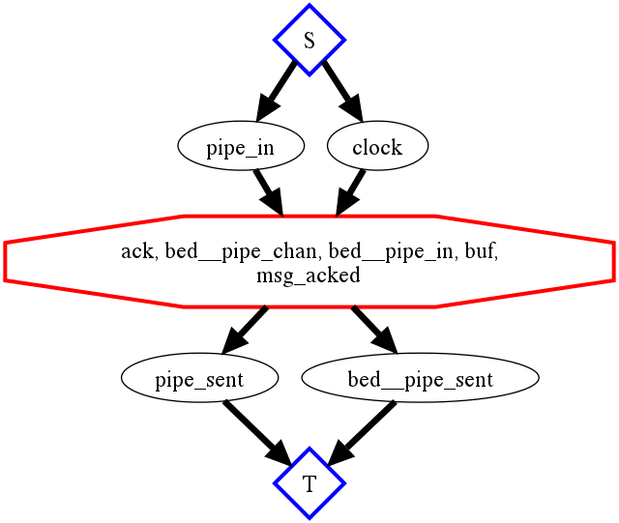
Concrete Implementations
bloom :done do
temp :msg_acked <= (buf * ack).lefts
(:ident => :ident)
pipe_sent <= msg_acked
buf <- msg_acked
end
end
module ReliableDelivery
include DeliveryProtocol
import BestEffortDelivery => :bed
state do
table :buf, pipe_in.schema
channel :ack, [:@src, :dst, :ident]
periodic :clock, 2
end
bloom :remember do
buf <= pipe_in
bed.pipe_in <= pipe_in
bed.pipe_in <= (buf * clock).lefts
end
bloom :send_ack do
ack <~ bed.pipe_chan do|p|
[p.src, p.dst, p.ident]
end
end

Slide 26
Concrete Implementations
bloom :done do
temp :msg_acked <= (buf * ack).lefts
(:ident => :ident)
pipe_sent <= msg_acked
buf <- msg_acked
end
end
module ReliableDelivery
include DeliveryProtocol
import BestEffortDelivery => :bed
state do
table :buf, pipe_in.schema
channel :ack, [:@src, :dst, :ident]
periodic :clock, 2
end
bloom :remember do
buf <= pipe_in
bed.pipe_in <= pipe_in
bed.pipe_in <= (buf * clock).lefts
end
bloom :send_ack do
ack <~ bed.pipe_chan do|p|
[p.src, p.dst, p.ident]
end
end
Asynchrony +
Nonmonotonicity

Slide 27
CALM Analysis

Slide 28
Monotonic Logic
The more you know, the more you know.
E.g., select, project, join, union
  (Filter, map, compose, merge)
Pipelinable
Insensitive to the ordering of inputs
Notes:
A op B. A = allies. Filter: B = (allies beginning with S) or Union: B = (allies and neutral countries)

Slide 29
Nonmonotonic Logic
Possible belief revision or retraction
(Un-firing missiles)
E.g. aggregation, negation as complement
  (Counting, taking a max/min, checking that an element isn’t in a hash)
Blocking
Ordering of inputs may affect results
Notes:
NM: B = non-allies or # of allies
Send roses/missiles to B.

Slide 30
Consistency
A family of correctness criteria for data-oriented systems
Do my replicas all converge to the same final state?
Am I missing any partitions?
State of the art: choose an extreme

Slide 31
Strong Consistency
Coordination: baked-in consistency via protocol
Serializable reads and writes, atomic transactions, ACID
2PC, paxos, GCS, etc
Establish a total order of updates
Problem: latency, availability

Slide 32
Strong Consistency

Slide 33
Loose Consistency
Application-specific correctness via “rules of thumb”
Asynchronous replication
Commutative (i.e., reorderable) operations
Custom compensation / repair logic
Tolerate all update orders
Problem: informal, fragile
Notes:
Assert that the “logical” effect of updates to local state is the same for ANY delivery order

Slide 34
Loose Consistency

Slide 35
CALM Conjecture
Consistency ``is’’ logical monotonicity

Slide 36
CALM Analysis
Logic programming dependency analysis applied to a distributed system
Represent program as a directed graph
  Nodes are collections
  Arcs are rules
    may be labeled asynchronous or nonmonotonic
Tools identify “points of order”
  Where different input orderings may produce divergent outputs

Slide 37
Points of order
Nonmonotonicity after asynchrony in dataflow
Asynchronous messaging => nondeterministic message orders
Nonmonotonic => order-sensitive
Coordination may be required to ensure convergent results.
Here (and only here) the programmer should reason about ordering!

Slide 38
Resolving points of order
Coordinate
  Enforce an ordering over inputs
  Or block till input set is completely determined

Slide 39
Resolving points of order
Coordinate
  Enforce an ordering over inputs
  Or block till input set is completely determined
Speculate
  Track ``taint’’
  Tainted conclusions may be retracted

Slide 40
Resolving points of order
Coordinate
  Enforce an ordering over inputs
  Or block till input set is completely determined
Speculate
  Track ``taint’’
  Tainted conclusions may be retracted
Rewrite
  ``Push down’’ points of order
    Past async edges (localize coordination)
    To edges with less flow (minimize coordination)

Slide 41
Resolving points of order
Coordinate
  Enforce an ordering over inputs
  Or block till input set is completely determined
Speculate
  Track ``taint’’
  Tainted conclusions may be retracted
Rewrite
  ``Push down’’ points of order
    Past async edges (localize coordination)
    To edges with less flow (minimize coordination)

Slide 42
Shopping Carts

Slide 43
Example application: a replicated shopping cart
Replicated to achieve high availability and low latency
Clients are associated with unique session ids
Add item, delete item and “checkout” operations
Challenge:
Ensure that replicas are ``eventually consistent’’

Slide 44
Carts done two ways
A “destructive” cart
  Use a replicated KVS as a storage system
  Client session id is the key
  Value is an array representing cart contents
  Checkout causes value array to be sent to client
A “disorderly” cart
  Accumulate (and asynchronously replicate) a set of cart actions
  At checkout, count additions and deletions, take difference
  Aggregate the summary into an array “just in time”

Slide 45
A simple key/value store
module KVSProtocol
state do
interface input, :kvput, [:key] => [:reqid, :value]
interface input, :kvdel, [:key] => [:reqid]
interface input, :kvget, [:reqid] => [:key]
interface output, :kvget_response,
[:reqid] => [:key, :value]
end
end

Slide 46
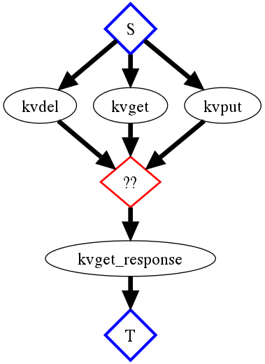
A simple key/value store
module KVSProtocol
state do
interface input, :kvput, [:key] => [:reqid, :value]
interface input, :kvdel, [:key] => [:reqid]
interface input, :kvget, [:reqid] => [:key]
interface output, :kvget_response,
[:reqid] => [:key, :value]
end
end

Slide 47
A simple key/value store
module BasicKVS
include KVSProtocol
state do
table :kvstate, [:key] => [:value]
end
bloom :mutate do
kvstate <+ kvput {|s| [s.key, s.value]}
kvstate <- (kvstate * kvput).lefts(:key => :key)
end
bloom :get do
temp :getj <= (kvget * kvstate).pairs(:key => :key)
kvget_response <= getj do |g, t|
[g.reqid, t.key, t.value]
end
end
bloom :delete do
kvstate <- (kvstate * kvdel).lefts(:key => :key)
end
end

Slide 48
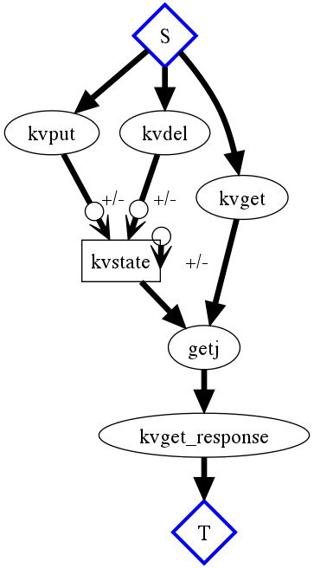
A simple key/value store
module BasicKVS
include KVSProtocol
state do
table :kvstate, [:key] => [:value]
end
bloom :mutate do
kvstate <+ kvput {|s| [s.key, s.value]}
kvstate <- (kvstate * kvput).lefts(:key => :key)
end
bloom :get do
temp :getj <= (kvget * kvstate).pairs(:key => :key)
kvget_response <= getj do |g, t|
[g.reqid, t.key, t.value]
end
end
bloom :delete do
kvstate <- (kvstate * kvdel).lefts(:key => :key)
end
end

Slide 49
A simple key/value store
module BasicKVS
include KVSProtocol
state do
table :kvstate, [:key] => [:value]
end
bloom :mutate do
kvstate <+ kvput {|s| [s.key, s.value]}
kvstate <- (kvstate * kvput).lefts(:key => :key)
end
bloom :get do
temp :getj <= (kvget * kvstate).pairs(:key => :key)
kvget_response <= getj do |g, t|
[g.reqid, t.key, t.value]
end
end
bloom :delete do
kvstate <- (kvstate * kvdel).lefts(:key => :key)
end
end
Nonmononic
operations

Slide 50
A simple key/value store
module BasicKVS
include KVSProtocol
state do
table :kvstate, [:key] => [:value]
end
bloom :mutate do
kvstate <+ kvput {|s| [s.key, s.value]}
kvstate <- (kvstate * kvput).lefts(:key => :key)
end
bloom :get do
temp :getj <= (kvget * kvstate).pairs(:key => :key)
kvget_response <= getj do |g, t|
[g.reqid, t.key, t.value]
end
end
bloom :delete do
kvstate <- (kvstate * kvdel).lefts(:key => :key)
end
end
Nonmononic
operations

Slide 51
A simple key/value store
module BasicKVS
include KVSProtocol
state do
table :kvstate, [:key] => [:value]
end
bloom :mutate do
kvstate <+ kvput {|s| [s.key, s.value]}
kvstate <- (kvstate * kvput).lefts(:key => :key)
end
bloom :get do
temp :getj <= (kvget * kvstate).pairs(:key => :key)
kvget_response <= getj do |g, t|
[g.reqid, t.key, t.value]
end
end
bloom :delete do
kvstate <- (kvstate * kvdel).lefts(:key => :key)
end
end
Nonmononic
operations

Slide 52
A simple key/value store
module BasicKVS
include KVSProtocol
state do
table :kvstate, [:key] => [:value]
end
bloom :mutate do
kvstate <+ kvput {|s| [s.key, s.value]}
kvstate <- (kvstate * kvput).lefts(:key => :key)
end
bloom :get do
temp :getj <= (kvget * kvstate).pairs(:key => :key)
kvget_response <= getj do |g, t|
[g.reqid, t.key, t.value]
end
end
bloom :delete do
kvstate <- (kvstate * kvdel).lefts(:key => :key)
end
end
Nonmononic
operations

Slide 53
``Destructive’’ Cart
module DestructiveCart
include CartProtocol
include KVSProtocol
declare
def queueing
kvget <= action_msg {|a| [a.reqid, a.session] }
kvput <= action_msg do |a|
if a.action == "Add" and not kvget_response.map{|b| b.key}.include? a.session
[a.client, a.session, a.reqid, Array.new.push(a.item)]
end
end
old_state = join [kvget_response, action_msg], [kvget_response.key, action_msg.session]
kvput <= old_state do |b, a|
if a.action == "Add"
[a.client, a.session, a.reqid, (b.value.clone.push(a.item))]
elsif a.action == "Del"
[a.client, a.session, a.reqid, delete_one(b.value, a.item)]
end
end
end
declare
def finish
kvget <= checkout_msg {|c| [c.reqid, c.session] }
lookup = join([kvget_response, checkout_msg], [kvget_response.key, checkout_msg.session])
response_msg <~ lookup do |r, c|
[r.client, r.server, r.key, r.value, nil]
end
end
end

Slide 54
``Destructive’’ Cart
module DestructiveCart
include CartProtocol
include KVSProtocol
declare
def queueing
kvget <= action_msg {|a| [a.reqid, a.session] }
kvput <= action_msg do |a|
if a.action == "Add" and not kvget_response.map{|b| b.key}.include? a.session
[a.client, a.session, a.reqid, Array.new.push(a.item)]
end
end
old_state = join [kvget_response, action_msg], [kvget_response.key, action_msg.session]
kvput <= old_state do |b, a|
if a.action == "Add"
[a.client, a.session, a.reqid, (b.value.clone.push(a.item))]
elsif a.action == "Del"
[a.client, a.session, a.reqid, delete_one(b.value, a.item)]
end
end
end
declare
def finish
kvget <= checkout_msg {|c| [c.reqid, c.session] }
lookup = join([kvget_response, checkout_msg], [kvget_response.key, checkout_msg.session])
response_msg <~ lookup do |r, c|
[r.client, r.server, r.key, r.value, nil]
end
end
end
React to client
updates
React to client
checkout

Slide 55
``Destructive’’ Cart

Slide 56
``Destructive’’ Cart
Asynchrony

Slide 57
``Destructive’’ Cart
Asynchrony
Nonmonotonicity

Slide 58
``Destructive’’ Cart
Asynchrony
Nonmonotonicity
Divergent Results?

Slide 59
``Destructive’’ Cart
Add coordination? E.g.,
Synchronous replication
Paxos

Slide 60
``Destructive’’ Cart
Add coordination? E.g.,
Synchronous replication
Paxos
n = |client_action|
m = |client_checkout| = 1
n rounds of coordination

Slide 61
``Disorderly Cart’’
module DisorderlyCart
include CartProtocol
state do
table :cart_action, [:session, :reqid] => [:item, :action]
scratch :action_cnt, [:session, :item, :action] => [:cnt]
scratch :status, [:server, :client, :session, :item] => [:cnt]
end
declare
def saved
cart_action <= action_msg { |c| [c.session, c.reqid, c.item, c.action] }
action_cnt <= cart_action.group([cart_action.session, cart_action.item, cart_action.action], count(cart_action.reqid))
end
declare
def consider
status <= (action_cnt * action_cnt * checkout_msg) do |a1, a2, c|
if a1.session == a2.session and a1.item == a2.item and a1.session == c.session and a1.action == "Add" and
a2.action == "Del"
[c.client, c.server, a1.session, a1.item, a1.cnt - a2.cnt] if (a1.cnt - a2.cnt) > 0
end
status <= (action_cnt * checkout_msg) do |a, c|
if a.action == "Add" and not action_cnt.map{|d| d.item if d.action == "Del"}.include? a.item
[c.client, c.server, a.session, a.item, a.cnt]
end
end
out = status.reduce({}) do |memo, i|
memo[[i[0],i[1],i[2]]] ||= []; i[4].times {memo[[i[0],i[1],i[2]]] << i[3]}; memo
end.to_a
response_msg <~ out {|k, v| k << v}
end
end

Slide 62
``Disorderly Cart’’
module DisorderlyCart
include CartProtocol
state do
table :cart_action, [:session, :reqid] => [:item, :action]
scratch :action_cnt, [:session, :item, :action] => [:cnt]
scratch :status, [:server, :client, :session, :item] => [:cnt]
end
declare
def saved
cart_action <= action_msg { |c| [c.session, c.reqid, c.item, c.action] }
action_cnt <= cart_action.group([cart_action.session, cart_action.item, cart_action.action], count(cart_action.reqid))
end
declare
def consider
status <= (action_cnt * action_cnt * checkout_msg) do |a1, a2, c|
if a1.session == a2.session and a1.item == a2.item and a1.session == c.session and a1.action == "Add" and
a2.action == "Del"
[c.client, c.server, a1.session, a1.item, a1.cnt - a2.cnt] if (a1.cnt - a2.cnt) > 0
end
status <= (action_cnt * checkout_msg) do |a, c|
if a.action == "Add" and not action_cnt.map{|d| d.item if d.action == "Del"}.include? a.item
[c.client, c.server, a.session, a.item, a.cnt]
end
end
out = status.reduce({}) do |memo, i|
memo[[i[0],i[1],i[2]]] ||= []; i[4].times {memo[[i[0],i[1],i[2]]] << i[3]}; memo
end.to_a
response_msg <~ out {|k, v| k << v}
end
end
Actions
Checkout

Slide 63
Disorderly Cart Analysis

Slide 64
Disorderly Cart Analysis
Asynchrony

Slide 65
Disorderly Cart Analysis
Asynchrony
Nonmonotonicity

Slide 66
Disorderly Cart Analysis
Asynchrony
Nonmonotonicity
Divergent
Results?

Slide 67
Disorderly Cart Analysis
n = |client_action|
m = |client_checkout| = 1
1 round of coordination

Slide 68
Replicated Disorderly Cart
Asynchronous (uncoordinated)
replication

Slide 69
Replicated Disorderly Cart
Asynchronous (uncoordinated)
replication
Still just 1 round
of coordination

Slide 70
Summary
Why disorderly?
  Order is expensive and sometimes distracting
When is order really needed?
  When nomonotonicity makes the computation order-dependent
What is coordination for?
  Re-establishing order, to guarantee consistency.
CALM <~ Bloom
  A disorderly programming language
  Tools to identify points of order

Slide 71
More
Resources:
http://bloom.cs.berkeley.edu
http://bloom-lang.org
Writeups:
Consistency Analysis in Bloom: A CALM and Collected Approach (CIDR’11)
Dedalus: Datalog in Time and Space (Datalog2.0)
The Declarative Imperative (PODS’10 Keynote address)
Model-theoretic Correctness Criteria for Distributed Systems (in submission)

Slide 72
Queries?

