Slide 1
Disk-Locality in Datacenter Computing Considered Irrelevant
Ganesh Ananthanarayanan, Ali Ghodsi, Scott Shenker, Ion Stoica

Slide 2
Data Intensive Computing
Basis of analytics in modern Internet services
Infrastructure of O(10,000) machines
Peta-bytes of storage
E.g., Google MapReduce [OSDI’04], Hadoop [Open Source], Dryad [EuroSys’07]…
Job → {Phase} → {Task}

Slide 3
Disk Locality
Disk bandwidth >> Network bandwidth
Co-locate tasks with their input
Tasks are I/O intensive
Solutions focus on disk-locality:
Improve it [EuroSys’10, EuroSys’11]
Fairness considerations [SOSP’09]
Evaluation metric [NSDI’11]
…
Notes:
Map tasks account for 59% of all tasks and 68% of all resources

Slide 4
Datacenter trends indicate…

Slide 5
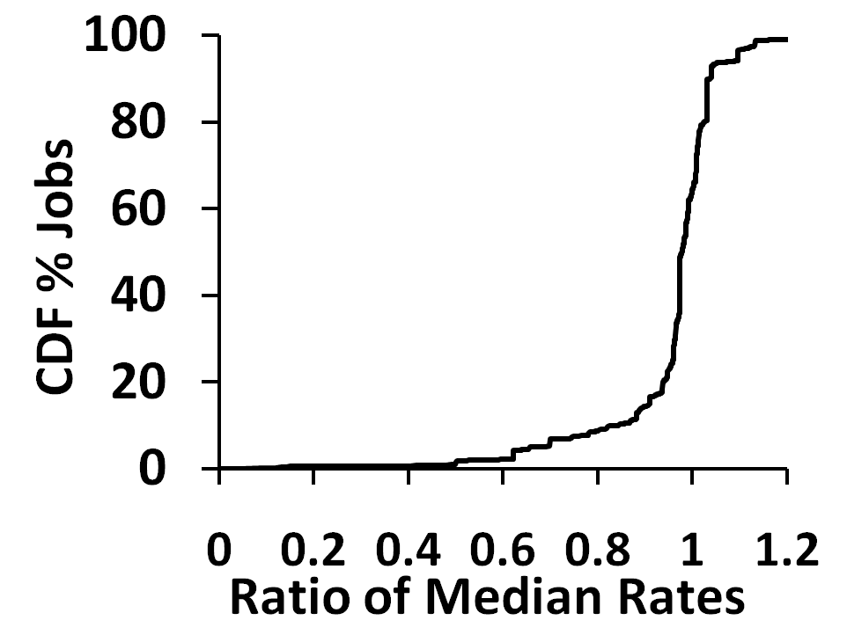
Fast Networks [1]
Three-layer hierarchy, traditionally
Access, Aggregate, Core switches
Link rates are improving…
Rack-local ~ Disk-local [Google, Facebook]
In 85% of jobs, rack-local tasks are as fast as disk-local tasks
Hadoop logs from Facebook
(Rack-local/Disk-local)
Rate = (Data)/(Time)

Slide 6
Fast Networks [2]
Over-subscription is fast reducing…
Full bisection bandwidth topologies [SIGCOMM-’08, ‘09]
Commodity switches → cost saving ($$$)
Adoption in today’s datacenters (Google?)

Slide 7
Storage Crunch [1]
Data mining algorithms perform better when fed with more data
Recommendations, advertisements etc.
Storage is no longer plentiful [Facebook]
Limits to growing the datacenter, non-linear if to move to a new datacenter
Data is stored compressed

Slide 8
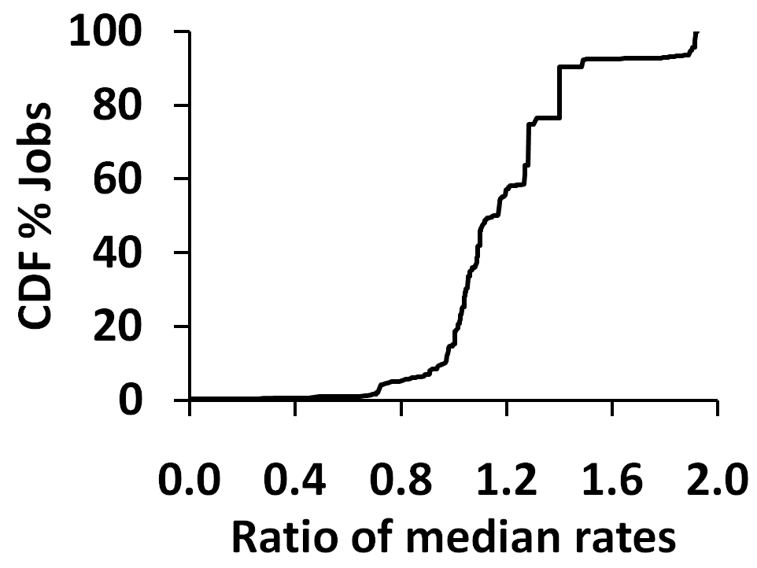
Storage Crunch [2]
Data compression → less data to read
Off-rack tasks only 1.4x slower (over-subscription of 10x)
Hadoop logs from Facebook
(Rack-local/Off-rack)
Rate = (Data)/(Time)

Slide 9
Disk Locality will be irrelevant!
Networks are getting faster, disks aren’t
Disks are the bottleneck
Storage is becoming a precious commodity
Data compression (→ reads don’t dominate)

Slide 10
Run any task anywhere?
Not so fast…
Memory reads are two magnitudes faster
Machines have memory of a few GB
Memory-locality is relevant!

Slide 11
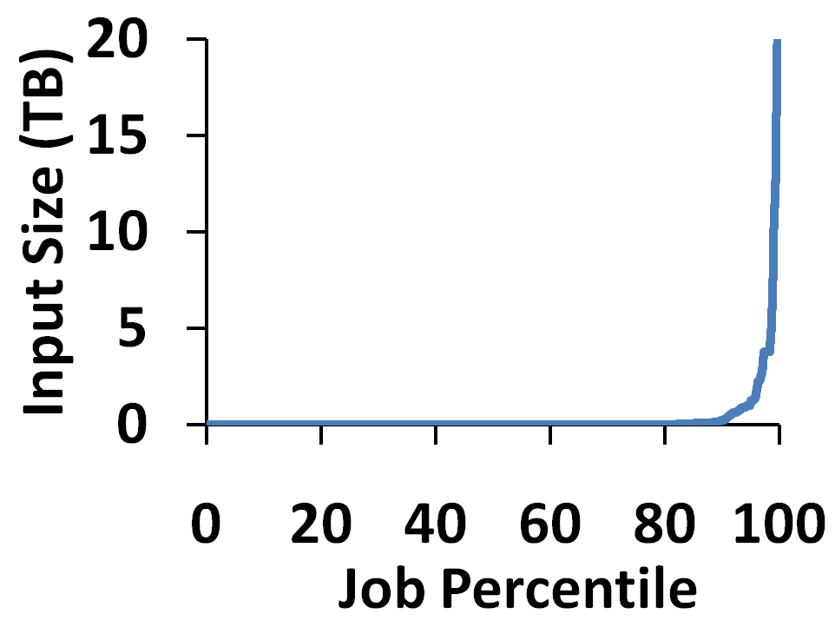
Let’s build a memory cache
Capacity is three orders less than disk
96% of jobs fit their data in memory
75% of blocks are singly-accessed
But only 11% of jobs

Slide 12
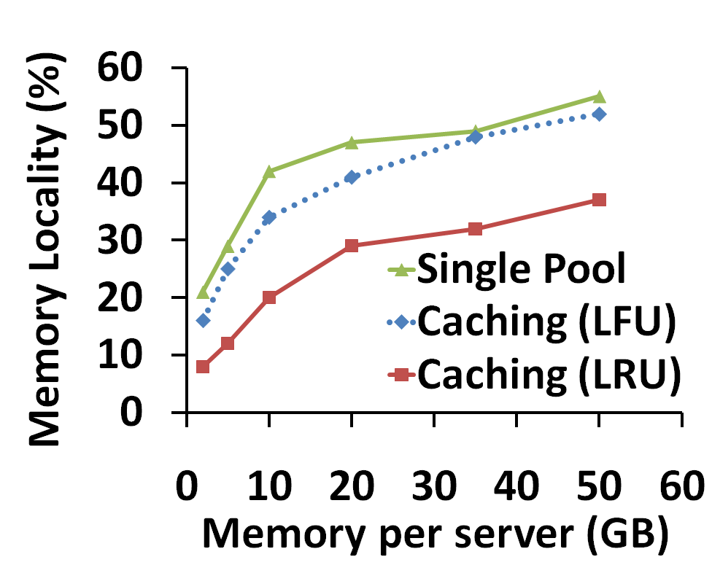
Cache Hit Rates
Memory-locality of 52%
Aggregated memory model doesn’t buy much
LFU is better than LRU
64% jobs have all their tasks memory-local

Slide 13
What next?
Pre-fetching Blocks
Out-of-band mechanisms
Cache Eviction
Preserve “whole” job inputs
Effect of workload
What if there aren’t so many small jobs?

Slide 14
Summary
Disk-locality is not required anymore
Networks are getting faster than disks
Storage crunch → Data compression → Reduces read component
Memory-locality should be the focus
Data fits into memory for 96% jobs
Encouraging early results

Slide 15
SSDs will not save us
Unlikely to replace disks – Economics don’t work out
Costs need to drop by ~3 orders, but are dropping by only 50% per year
Ever-increasing storage demands will not be met by deploying SSDs

