Slide 1
Towards a Scalable Database Service
Samuel Madden
MIT CSAIL
With Carlo Curino, Evan Jones, and Hari Balakrishnan

Slide 2
The Problem with Databases
Tend to proliferate inside organizations
  Many applications use DBs
Tend to be given dedicated hardware
  Often not heavily utilized
Don’t virtualize well
Difficult to scale
This is expensive & wasteful
  Servers, administrators, software licenses, network ports, racks, etc …

Slide 3
RelationalCloud Vision
Goal: A database service that exposes self-serve usage model
  Rapid provisioning: users don’t worry about DBMS & storage configurations
Example:
User specifies type and size of DB and SLA
(“100 txns/sec, replicated in US and Europe”)
User given a JDBC/ODBC URL
System figures out how & where to run user’s DB & queries
Notes:
Underlying technology handles all the other details

Slide 4
Before: Database Silos and Sprawl
Application #3
Must deal with many one-off database configurations
And provision each for its peak load
Application #1
$$
$$
Database #1
Database #3
Application #4
Application #2
$$
$$
Database #4
Database #2

Slide 5
After: A Single Scalable Service
App #4
App #1
App #2
App #3
Reduces server hardware by aggressive workload-aware multiplexing
Automatically partitions databases across multiple HW resources
Reduces operational costs by automating service management tasks

Slide 6
What about virtualization?
Could run each DB in a separate VM
Existing database services (Amazon RDS) do this
  Focus is on simplified management, not performance
Doesn’t provide scalability across multiple nodes
Very inefficient
Max Throughput w/ 20:1 consolidation (Us vs. VMWare ESXi)
All DBs equal load
One DB 10x loaded

Slide 7
Key Ideas in this Talk
How to place many databases on a collection of fewer physical nodes
  To minimize total nodes
  While preserving throughput
  Focus on transaction processing (“OLTP”)
How to automatically partition transactional (OLTP) databases in a DBaaS

Slide 8
System Overview
Initial focus is on OLTP
Schism
2
Kairos
1
Not going to talk about:
Database migration
Security

Slide 9
Kairos: Database Placement
Database service will host thousands of databases (tenants) on tens of nodes
  Each possibly partitioned
  Many of which have very low utilization
Given a new tenant, where to place it?
  Node with sufficient resource “capacity”
Curino et al, SIGMOD 2011
Notes:
why not VM per database?
- VMs waste resources on extra copy of OS, DBMS per datbase
- VMs can’t properly estimate resource requirements of a database
- VMs don’t understand historical utilization of a DBMS

Slide 10
Kairos Overview
1
Each node runs
1 DBMS

Slide 11
Resource Estimation
Goal: RAM, CPU, Disk profile vs time
OS stats:
  top – CPU
  iostat – disk
  vmstat – memory
Problem: DBMSs tend to consume entire buffer pool (db page cache)

Slide 12
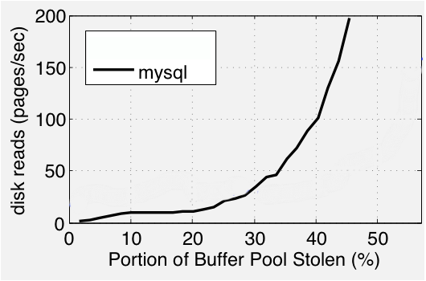
Buffer Pool Gauging for RAM
Goal: determine portion of buffer pool that contains actively used pages
Idea:
  Create a probe table in the DB,
  Insert records into it, and scan repeatedly
    Keep growing until number of buffer pool misses goes up
  Indicates active pages being evicted:
    |Working Set | = |Buffer Pool | - |Probe Table |
953 MB Bufferpool, on TPC-C 5W (120-150 MB/WH)

Slide 13
Kairos Overview
1
2
Each node runs
1 DBMS

Slide 14
Combined Load Prediction
Goal: RAM, CPU, Disk profile vs. time for several DBs on 1 DBMS
  Given individual resource profiles
(Gauged) RAM and CPU combine additively
Disk is much more complex

Slide 15
How does a DBMS use Disk?
OLTP working sets generally fit in RAM
Disk is used for:
  Logging
  Writing back dirty pages (for recovery, log reclamation)
In combined workload:
  Log writes interleaved, group commit
  Dirty page flush rate may not matter

Slide 16
Disk Model
Goal: predict max I/O throughput
Tried: analytical model
  Using transaction type, disk metrics, etc.
Interesting observation:
Regardless of transaction type, max update throughput of a disk depends primarily on database working set size
*In MySQL, only if
working set fits in RAM

Slide 17
Interesting Observation # 2
N combined workloads produce the same load on the disk as 1 workload with the same aggregate size and row update rate
Notes:
why --- # disk writes is proportional log writes, and rate at which pages are written back (more spread around writes cause more write backs)
➔By just sizing working set and rows updated/sec of a workload, we can predict how it will combine with other workloads

Slide 18
Kairos Overview
3
1
2
Each node runs
1 DBMS

Slide 19
Node Assignment via Optimization
Goal: minimize required machines (leaving headroom), balance load
Implemented in DIRECT non-linear solver; several tricks to make it go fast
Notes:
All 4 server solutions cheaper than all 5 server solutions, etc
Cost of a N server solution is lower the more balanced it is.

Slide 20
Balanced Load
“Balanced” → utilization of a resource on each node is equal.
  A property of the historical time series of load on each node
• “Imbalance” is proportional to difference in mean load on nodes
• System imbalance is the weighted sum of RAM, disk, and CPU imbalance.

Slide 21
Optimizing Optimization
Optimization is non-linear
  Combined disk model, use of time series
Use DIRECT non-linear solver
Slow – optimize by bounding number of machines considered by solution
  Upper bound: one machine per server, or greedy bin backing
  Lower bound: fractionally assign resources

Slide 22
Experiments
Two types
  Small scale tests of resource models and consolidation on our own machines
    Synthetic workload, TPC-C, Wikipedia
  Tests of our optimization algorithm on 200 MySQL server resource profiles from Wikipedia, Wikia.com, and Second Life
All experiments on MySQL 5.5.5

Slide 23
Validating Resource Models
Experiment: 5 Synthetic Workloads that Barely fit on 1 Machine
Buffer pool gauging allows us to accurately estimate RAM usage
Baseline: resource usage is sum of resources used by consolidated DBs
Disk model accurately predicts disk saturation point

Slide 24
Effect of Consolidation on Performance
Dataset | Throughput |  | Avg. Latency
 | w/o cons. | w/cons. | w/o cons. | w/cons.
TPC-C (10w) Wiki (100K pgs) | 50 tps 100 tps | 50 tps 100 tps | 76 ms 12.7 ms | 98 ms 16 ms
TPC-C (10w) Wiki (100K pgs) | 250 tps 500 tps | 250 tps 500 tps | 113 ms 43 ms | 180 ms 49 ms
5xTPC-C (10w) | 5x100 tps | 5x100 tps | 77 ms | 110 ms
8xTPC-C (10w) Wiki (100K pgs) | 8x50 tps 50 tps | 8x50 tps 50 tps | 76 ms 12.7 ms | 125.8 ms 19 ms

Slide 25
Measuring Consolidation Ratios in Real World Data
Tremendous consolidation opportunity in real databases
Load statistics from real deployed databases
  Does not include gauging disk model
Greedy is a first-fit bin packer
  Can fail because doesn’t handle multiple resources
Notes:
xxx explain

Slide 26
Kairos vs Other Techniques
Max Throughput w/ 20:1 consolidation (VMWare ESXi)
All DBs equal load
One DB 10x loaded
Max Throughput w/ Variable Consolidation (one OS, separate DBMSs)

Slide 27
System Overview
Schism
2
Kairos
1
OTLP

Slide 28
This is your OLTP Database
Curino et al, VLDB 2010

Slide 29
This is your OLTP database on Schism

Slide 30
Schism
New graph-based approach to automatically partition OLTP workloads across many machines
Input: trace of transactions and the DB
Output: partitioning plan
Results: As good or better than best manual partitioning
Static partitioning – not automatic repartitioning.

Slide 31
Challenge: Partitioning
Goal: Linear performance improvement when adding machines
Requirement: independence and balance
Simple approaches:
Total replication
Hash partitioning
Range partitioning

Slide 32
Partitioning Challenges
Transactions access multiple records?
Distributed transactions
Replicated data
Workload skew?
Unbalanced load on individual servers
Many-to-many relations?
Unclear how to partition effectively

Slide 33
Many-to-Many: Users/Groups

Slide 34
Many-to-Many: Users/Groups

Slide 35
Many-to-Many: Users/Groups

Slide 36
Distributed Txn Disadvantages
Require more communication
At least 1 extra message; maybe more
Hold locks for longer time
Increases chance for contention
Reduced availability
Failure if any participant is down

Slide 37
Example
Single partition: 2 tuples on 1 machine
Distributed: 2 tuples on 2 machines
Each transaction writes two different tuples

Slide 38
Schism Overview

Slide 39
Schism Overview
Build a graph from a workload trace
  Nodes: Tuples accessed by the trace
  Edges: Connect tuples accessed in txn

Slide 40
Schism Overview
Build a graph from a workload trace
Partition to minimize distributed txns
Idea: min-cut minimizes distributed txns

Slide 41
Schism Overview
Build a graph from a workload trace
Partition to minimize distributed txns
“Explain” partitioning in terms of the DB

Slide 42
Building a Graph

Slide 43
Building a Graph

Slide 44
Building a Graph

Slide 45
Building a Graph

Slide 46
Building a Graph

Slide 47
Building a Graph

Slide 48
Replicated Tuples

Slide 49
Replicated Tuples

Slide 50
Partitioning
Use the METIS graph partitioner:
min-cut partitioning with balance constraint
Node weight:
# of accesses → balance workload
data size → balance data size
Output: Assignment of nodes to partitions

Slide 51
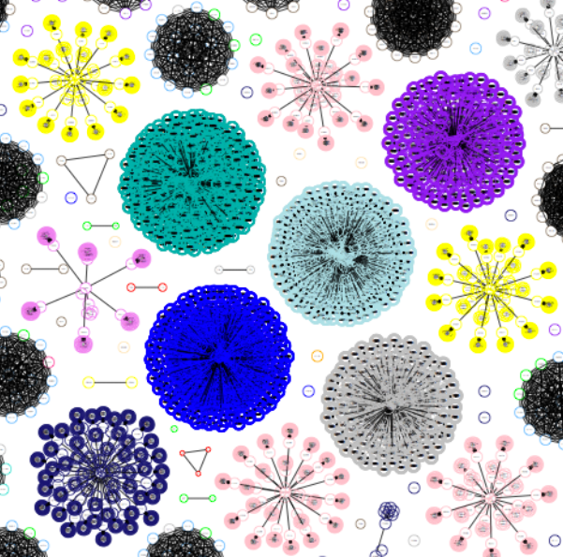
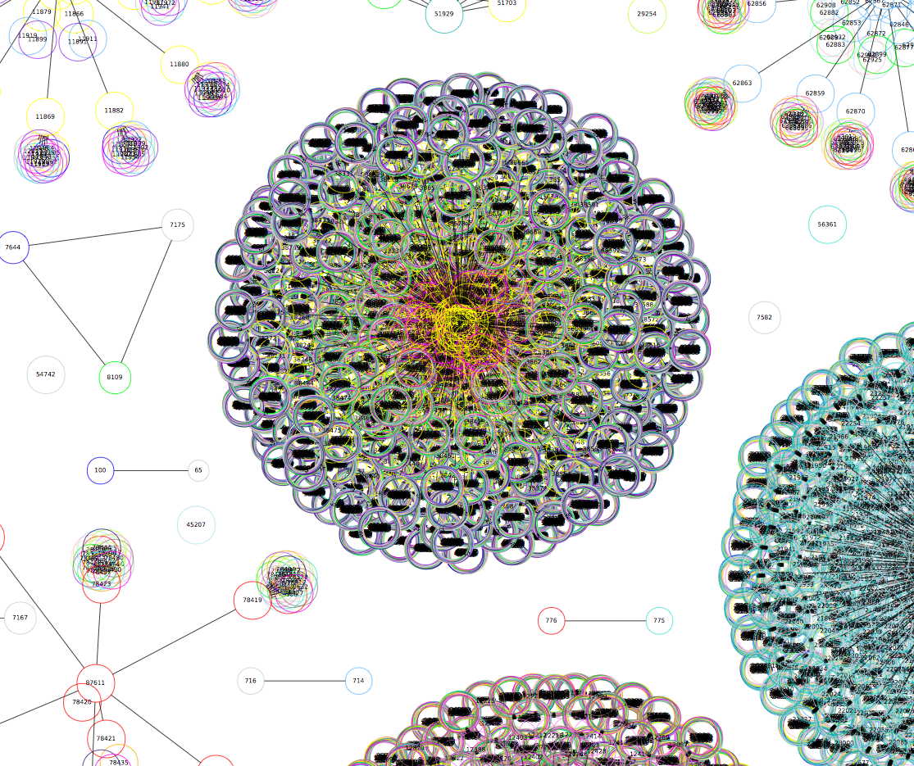
Example
Yahoo – hash
partitioning
Yahoo – schism partitioning

Slide 52
Graph Size Reduction Heuristics
Coalescing: tuples always accessed together → single node (lossless)
Blanket Statement Filtering: Remove statements that access many tuples
Sampling: Use a subset of tuples or transactions

Slide 53
Explanation Phase
Goal:
Compact rules to represent partitioning
Users
Partition
4
2
5
1
1
2
1
2

Slide 54
Explanation Phase
Goal:
Compact rules to represent partitioning
Classification problem:
tuple attributes → partition mappings
Users
Partition
4 | Carlo | Post Doc. | $20,000
2 | Evan | Phd Student | $12,000
5 | Sam | Professor | $30,000
1 | Yang | Phd Student | $10,000
1
2
1
2
Notes:
XXX fix

Slide 55
Decision Trees
Machine learning tool for classification
Candidate attributes:
attributes used in WHERE clauses
Output: predicates that approximate partitioning
Users
Partition
IF (Salary>$12000)
P1
ELSE
P2
4 | Carlo | Post Doc. | $20,000
2 | Evan | Phd Student | $12,000
5 | Sam | Professor | $30,000
1 | Yang | Phd Student | $10,000
1
2
1
2

Slide 56
Evaluation Phase
Compare decision tree solution with total replication and hash partitioning
Choose the “simplest” solution with the fewest distributed transactions

Slide 57
Implementing the Plan
Use partitioning support in existing databases
Integrate manually into the application
Middleware router: parses SQL statements, applies routing rules, issues modified statements to backends

Slide 58
Partitioning Strategies
Schism: Plan produced by our tool
Manual: Best plan found by experts
Replication: Replicate all tables
Hashing: Hash partition all tables

Slide 59
Benchmark Results: Simple
% Distributed Transactions

Slide 60
Benchmark Results: TPC
% Distributed Transactions

Slide 61
Benchmark Results: Complex
% Distributed Transactions

Slide 62
Schism
Automatically partitions OLTP databases as well or better than experts
Graph partitioning combined with decision trees finds good partitioning plans for many applications

Slide 63
Conclusion
Many advantages to DBaaS
  Simplified management & provisioning
  More efficient operation
Two key technologies
  Kairos: placing databases or partitions on nodes to minimize total number required
  Schism: automatically splitting databases across multiple backend nodes

Slide 64
Graph Partitioning Time

Slide 65
Collecting a Trace
Need trace of statements and transaction ids (e.g. MySQL general_log)
Extract read/write sets by rewriting statements into SELECTs
Can be applied offline: Some data lost

Slide 66
Validating Disk Model

Slide 67
Effect of Latency

Slide 68
Workload Predictability

Slide 69
Replicated Data
Read: Access the local copy
Write: Write all copies (distributed txn)
Add n + 1 nodes for each tuple
n = transactions accessing tuple
connected as star with weight = # writes
Cut a replication edge: cost = # of writes

Slide 70
Partitioning Advantages
Performance:
Scale across multiple machines
More performance per dollar
Scale incrementally
Management:
Partial failure
Rolling upgrades
Partial migrations

