Slide 1
transactional storage for geo-replicated systems
marcos k. aguilera microsoft research silicon valley
joint work with
yair sovran
russell power
jinyang li

Slide 2
one slide summary
walter is a key-value store for web apps, featuring
transactions
data replication across distant sites (geo-replication)
transactional semantics: parallel snapshot isolation (PSI)
property is strong, yet it has efficient implementation
implementation of PSI uses two techniques
preferred sites
counting sets
using walter, we built two geo-replicated apps
facebook-like app, twitter-like app

Slide 3
motivation
web applications growing in size
social networks, web mail, messaging
beyond a single data center or site
more capacity: world-wide user base
access locality: web users get local service
disaster tolerance: if site fails others can take over
goal: infrastructure for developing apps deployed on many sites

Slide 4
architecture of a web application
shared persistent state only at bottom tier
higher tiers have only private session state or no state
to deploy at many sites, replicate picture at each site
hard part, which our work concerns: storage tier
state possibly shared among users

Slide 5
existing solutions for storage tier
replicated database systems
single-master: updates must be done at one server
multi-master: application must resolve conflicts
hard and expensive to scale
highly-scalable storage (Google, Amazon, HP, etc)
either single site systems [SDDS, BigTable, GFS, Sinfonia, Percolator]
or limited or no support for transactions [PNUTS, Cassandra]
or poor multi-site performance [Megastore]

Slide 6
walter: multi-site storage system
geo-replication = replication across sites
transactions (next slide)
non-structural choice
interface based on key-value pairs write(key,value) read(key)
terminology: object = key-value pair

Slide 7
why transactions in storage system?
help dealing with hard problems arising from concurrency+failures
transfer hard problems from application to storage infrastructure
fewer storage systems than applications
infrastructure developers have better expertise

Slide 8
why transactions, part two: life without transactions
issue of integrity of the storage state
dangling references
orphan objects
unexpected reference cycles
garbage
resulting in
code complexity
lack of productivity
loss of software quality
our goal in providing transactions: facilitate job of web developer without sacrificing performance

Slide 9
transaction coordination and anomalies
less coordination, more anomalies
parallel
snapshot isolation (PSI)
eventual
consistency
snapshot isolation
serializability

Slide 10
snapshot isolation
supported by commercial DB systems
properties
reads performed on a consistent snapshot
writes concentrated at commit time
no write-write conflicts

Slide 11
issue with snapshot isolation
it orders the commit time of all transactions even those that do not conflict with each other
forbids some scenarios we want to allow for efficiency

Slide 12
issue with snapshot isolation (cont’d)
scenario forbidden by snapshot isolation (it requires total ordering of update transactions)
Alice
Bob
initial state
initial state
A1. update transaction
upload photo
B1. update transaction
upload photo
A2. read transaction (see own update)
B2. read transaction
(see own update)
see own photo
see own photo
A3. read transaction
B3. read transaction

Slide 13
parallel snapshot isolation (PSI)
snapshot isolation
PSI
one commit time
one timeline
read from snapshot
no write-write conflicts
a commit time per site
a timeline per site
read from snapshot at site
ditto
causality property

Slide 14
parallel snapshot isolation (PSI)
features
(1) commit time per site, (2) timeline per site, (3) read from snapshot at site, (4) no write-write conflicts (5) causality: if T1 commits at site S before T2 starts at site S then T2 does not commit before T1 at any site

Slide 15
implementing PSI efficiently
PSI prohibits write-write conflicts (even across sites)
issue: how to enforce it efficiently? (without coordination across sites)
two techniques
preferred sites: optimize updates at certain sites
counting sets: data structure that eliminates conflicts

Slide 16
technique #1: preferred sites
each object assigned a preferred site
at that site, object can be written efficiently
transactions that modify objects at their preferred site can use fast commit (without cross-site communication)
inspired by notion of a primary site
but less restrictive, because objects modifiable at any site
example of usage: web application
preferred site of objects of a user = site close to where user usually logs in from

Slide 17
potential performance issue
what if many sites often modify an object?
no good way to assign a preferred site to object
bad idea: keep changing preferred sites of object
requires cross site communication
defeats efficiency goal

Slide 18
technique #2: counting sets
goal: eliminate conflicts
when clients update the same object concurrently, most likely they do not want to overwrite it
otherwise we have a race condition
cast concurrent updates as operations on a set
example: users B and C adds themselves to A’s friends list
instead of writes, treat updates as set additions
set addition commutes, so conflict eliminated

Slide 19
counting sets (cont’d)
beyond opaque key-value pairs
value in key-value pair treated as a set
primitive operations in transactions
not just reads, writes, but also set operations
transaction manager understands some updates are commutative so they do not conflict
want: all set operations to commute with each other
so no need to check for conflicts at all
but set operations are not always commutative

Slide 20
counting sets: anti-elements
example of non-commutative operations
Alice: add x to set S
Bob: remove x from set S
different execution order = different outcome
goal: make all operations commutative
counting set = map from id to counter (negative values ok)
add: increment counter remove: decrement counter
removing from empty set: set with “anti-element”
increment and decrement always commute, so no conflicts

Slide 21
putting both techniques together
certain transactions: fast execution and commit
= without cross site communication
if preferred site of written objects is local or
updates done on counting sets objects
other transactions: slow commit
= with cross site communication

Slide 22
walter API
start(): void
commit(): int
abort(): int
read(oid, buffer): int
write(oid, buffer, length): int
setAdd(csetoid, id): int
setDel(csetoid, id): int
setRead(csetoid, iterator): int
C++ example
Tx x;
x.start();
len = x.read(o1, &buf); err = x.write(o2, buf, len);
res = x.commit();
PHP example
$x = waStartTx();
$buf = waRead($x, $o1); $err = waWrite($x, $o2, $buf);
$res = waCommit($x);

Slide 23
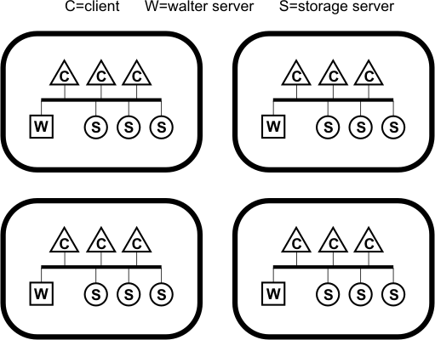
walter architecture

Slide 24
scalability
walter server can be scalability bottleneck on site
solutions
1. smaller sites, many per data center
2. distribute walter server
replace commit with distributed commit
data center 1
data center 2

Slide 25
partial replication
objects need not be replicated at all sites
replica set chosen by administrator
application can access any object
even if not locally replicated
system gives illusion all objects replicated at all sites
system retrieves appropriate version from remote site
useful for large state (e.g., user’s emails)

Slide 26
using walter: applications
built waltSocial
social networking application
runs on many sites
2. ported reTwis to run on many sites
existing twitter clone written in PHP
original uses redis key-value store (single site)
replaced redis with walter

Slide 27
waltSocial
simple social networking application
supports common operations, such as
befriend
post message on wall
read info
uses counting sets
friends list, message list
preferred site
site close to user
where user logs into
/* befriend operation */
Tx x;
x.start();
x.read(oidA, &profileA);
x.read(oidB, &profileB);
x.setAdd(profileA.friendlist, oidB);
x.setAdd(profileB.friendlist, oidA);
success = x.commit();

Slide 28
reTwis
twitter clone
uses redis key-value store
supports atomic operations on lists, counters
works on a single site (*)
(*) redis supports replication across sites, but it is limited to a master-slave scheme
we replaced redis with walter
to support multi-site operation
atomic operations replaced with transactions
uses counting set to store timeline
port done in less than a day

Slide 29
evaluation
used Amazon EC2 with four sites
Virginia (VA), California (CA), Ireland (IE), Singapore (SG)
round-trip latency from 82ms (VA-CA) to 277ms (IE-SG)
some experiments on local cluster, because
EC2 performance was poor with many threads
EC2 has write caching at the disks
experiments evaluate
performance of walter
performance of applications of walter

Slide 30
walter performance, one site
base performance on one site
done on local cluster not EC2
in EC2, performance is halved
 | read transactions | write transactions
walter | 72 Ktps | 34 Ktps
berkeley db | 80 Ktps | 32 Ktps

Slide 31
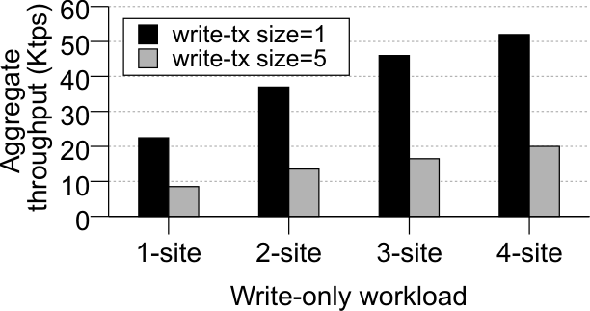
walter performance, many sites write workload on EC2, full replication

Slide 32
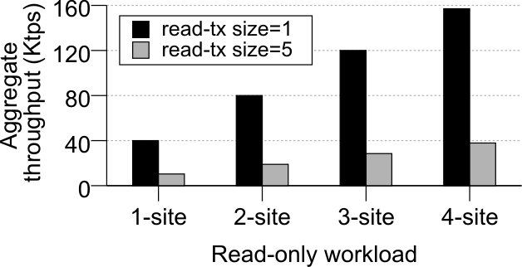
walter performance, many sites read workload on EC2, full replication

Slide 33
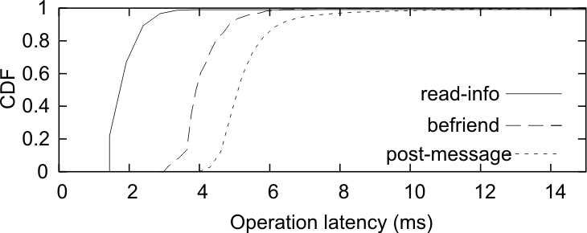
waltSocial performance on 4 sites in EC2, full replication
operation | # objects accessed | throughput
read info | 3 | 40 Kops/s
befriend | 4 | 20 Kops/s
post message | 6 | 17 Kops/s

Slide 34
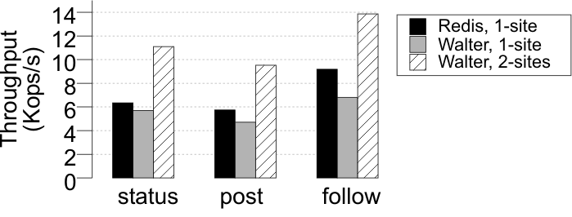
reTwis performance in EC2

Slide 35
related work
commutative replicated types
inspired counting sets, but proposed types different
cloud storage systems
single-site only: Bigtable, Sinfonia, Percolator, distributed b-tree
no or limited transactions: Dynamo, PNUTS, COPS
multi-site, synchronous replication: Megastore
database systems literature
replication: provides serializability or snapshot isolation=slow
escrow transactions: for numeric data, slow
eventual consistency
requires conflict resolution logic

Slide 36
conclusion
web apps increasingly deployed over many sites
developers need appropriate storage infrastructure
transactions are a powerful abstraction
can provide transactions with reasonable performance
semantics: parallel snapshot isolation
techniques
preferred sites
counting sets

Slide 37
one slide summary
walter is a key-value store for web apps, featuring
transactions
data replication across distant sites (geo-replication)
transactional semantics: parallel snapshot isolation (PSI)
property is strong, yet it has efficient implementation
implementation of PSI uses two techniques
preferred sites
counting sets
using walter, we built two geo-replicated apps
facebook-like app, twitter-like app

Slide 38
backup slides

Slide 39
containers
an object has metadata
replica set: where it is replicated
preferred site
too wasteful to keep metadata per object
objects are grouped into containers
objects in a container share metadata

Slide 40
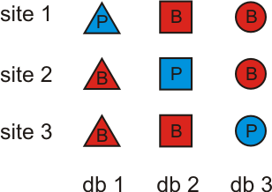
preferred versus primary sites
definition-wise: primary is more restrictive
preferred allows writes at any site
context-wise: also more restrictive
use many primary-backup databases
transactions cannot cross databases
or semantics unclear

Slide 41
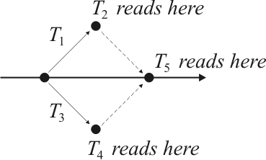
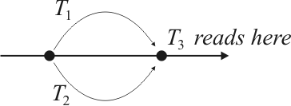
anomalies
Anomaly | Serializ-ability | Snapshot Isolation | PSI | Eventual Consistency
short fork | No | Yes | Yes | Yes
long fork | No | No | Yes | Yes
conflicting fork | No | No | No | Yes
dirty read | No | No | No | Yes
non-repeatable read | No | No | No | Yes
lost update | No | No | No | Yes
short fork (write skew)
long fork

Slide 42
using PSI
multi-object atomic updates
all writes in transaction happen together
snapshots
reads come from snapshot of data
read-modify-write operations
transactions read object and writes updated version
conditional writes
transaction reads object, checks condition, and modify object only if condition holds
can check and write many objects at once
others?

