Slide 1
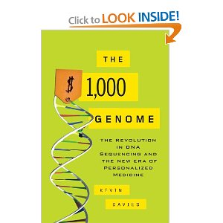
Querying a Million Genomes in less than a millisecond?
Interpreting the Genome
Technology Review 2009
New technologies will soon make it possible to sequence thousands of human genomes. Now comes the hard part: understanding all the data.
George Varghese (MSR, UCSD)
( with V. Bafna, C. Kozanitis, UCSD)

Slide 2

Genome Trends
Cheap: cost falling faster than Moore’s Law: $100M (2001)→ $10K (2012) → $1K (2014?)
Velocity: 30,000 Genomes in 2011 versus 2700 in 2010. BGI: 40,000 sequences per year
Medical Records: EMRs by 2014: HITECH Act
Cancer Genomics: killer app?
  8M cases/year. Fundamentally genomic
  Blockbuster drugs: Herceptin, Gleevec
  Cancer Genome Atlas: 5000 cases → 25,000
Notes:
The trends are astounding. Genome costs are falling faster than Moore’s Law on track to reach a $1000 in a few years. This has resulted in an acceleration of sequenced human genomes, While only 30,000 genomes were produced in 2011, Beijing Genomic Institute last year purchased 128 sequencers capable of producing 40,000 sequences a year in just one location. At the same, the HITECH act requires that most medical records be electronic by 2012. The joining of medical records and genomics suggests new therapeutic approaches based on genomics, In particular, cancer is the 2nd largest cause of mortality and is a genomic disease. Some recent blockbuster drugs like Gleevec used the genetis to block some molecular pathways. While Gleevec works well for luekemia, much work is required to find the genetic variations and drugs underlying other cancers.

Slide 3
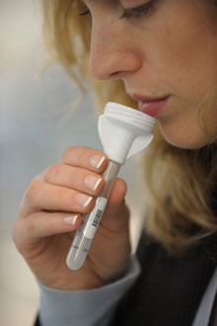
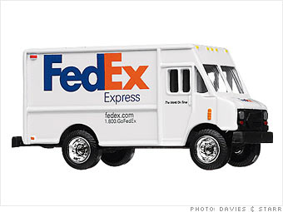
Biology today: Data rich but . . .
Assemble: patients and normals (months)
Sequence: and align (1 day)
Analyze: Ad hoc program to suggest hypotheses on genetic/disease correlation. Iterate (months)
Share: Rare→ 250G needs FedEx (days)
Notes:
While this is good news, Biology today is data rich but analysis poor. While analysis does exist, there are manual aspects of it that Berkeley SNAP: speeds up a key part of Step 2 in Process, but other Steps are the bottleneck

Slide 4


Imagine instead research . . .
Genomes
Diseases
G1
L
H
G2
H
G1K
L
G2K
B
Pax3, L?
Location, Disease→ Gene Text
Browsing

Slide 5

Imagine drug discovery . . .
Genomes
Diseases
G1
L
H
G2
H
G1K
L
G2K
B
Dels, H?
Variation, Disease→ Locations
Discovery

Slide 6
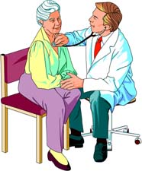
Reimagine Medicine. . .
Genomes
Treatments
G1
L
H
G2
H
G1K
L
G2K
x
B
Iloprost
SNP 30, B?
Variation, Disease→ Treatment
Iloprost
Personalized Medicine

Slide 7
Biology tomorrow: Interactive analysis?
Assemble: patients, normals (Select: msec)
Sequence: align, store (precomputed)
Analyze: Generate hypotheses on genetic disease correlation. Iterate (queries: msec)
Share: Common? (share answers, queries: msec)
Still present but done before insertion into database
Notes:
Potentially transformational in allowing rapid hypothesis generation and allowing widespread and easy collaboration. Note that wet lab portions are still required: first to prepare samples before placing in database, and secondly after a hypothesis is framed, to test it using say mouse models and patient trials. FedEx also remains the best way to transport sequenced genomes to the cloud storage location.

Slide 8
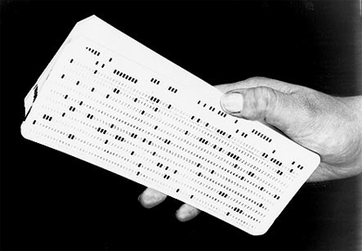

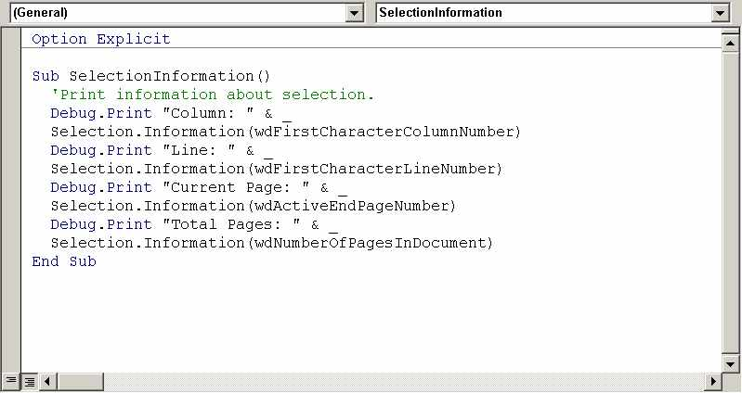
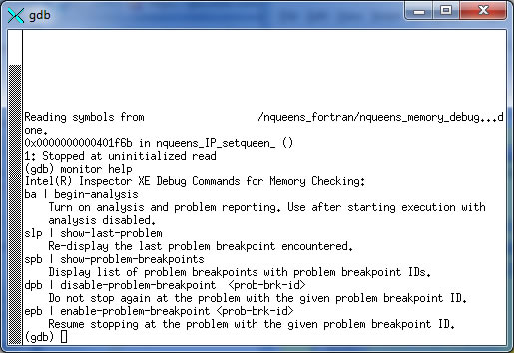
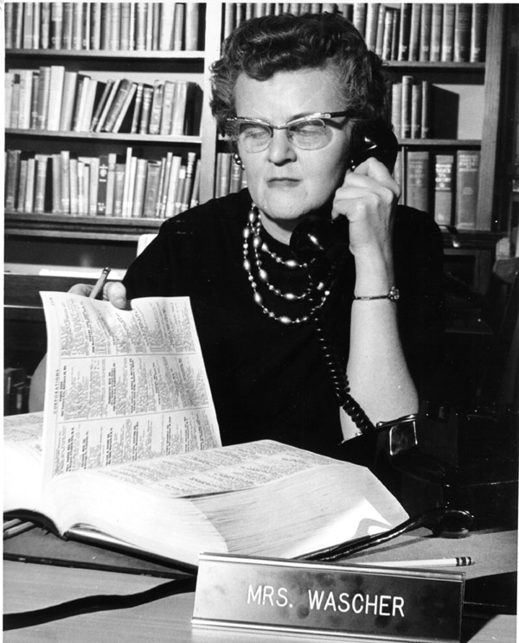
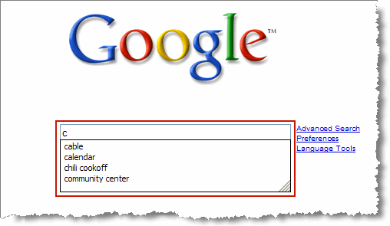
Interactivity can be transformative
Batch
Timesharing
Debugging
Search

Slide 9
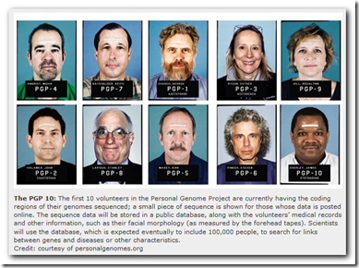
Initial database already . . .
PGP 10 -> FIRST 10 VOLUNTEERS . . . NOW 2000 STRONG
GENOMES + MEDICAL RECORDS, NO PRIVACY, CRUDE QUERYING
Notes:
This is not so far-fetched. The Personal Genome Project has already started such a database of volunteers. PGP-9 for example is Steven Pinker, the well known linguist and physchologist

Slide 10
But existing systems do not suffice
SAM Tools: Focused on one variation (SNPs). All READs from 1 position
GATK: Iterator model with Hadoop Backend. Procedural. No querying
SciDB: Focus on telescopy and other use cases; common themes however.

Slide 11
So what’s needed for vision?
Specification of the APIs
  GQL Proposal
Implementation (Structure)
  App/Inference/Evidence/Instrument Layers
Implementation (Scaling, Performance)
  Indices/Materialized Views/Parallelization
Standardizing Inference
Privacy, social aspects
Important but ignored in this talk

Slide 12
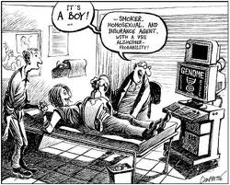
Notwithstanding dangers . . .
It’s a BOY!
Smoker , Berkeley Prof, 60% chance of Alzheimer's by 40
Notes:
Of course, undergirding genomics is a number of ethical, physchological and scoietal issues some of which are captured in this cartoon.

Slide 13
Outline
Background
Specification
Implementation
Research Ideas

Slide 14
Background
Notes:
In order to explain the sample queries posed to a large system – biological hardware and computer system software -- for personalized medicine, let me start with a quick metaphor on some relevant aspects of genomics and in each case let the metaphor illustrate a few of the key processing queries that biologists and clinicians seem to be interested in

Slide 15
Sequencing Process
ACCCCAACCGAAA . . . . . .GCCACA
From Pa
ACCCCAACCGAAA . . . . . .GCAACA
From Ma
CCAA
GCAA
Reads
Align with errors
Reference
With Short Reads, no assembly only alignment
Notes:
Note that reference is haploid: its only one program that is a composite of many individuals. It sort of works because most human DNA is the same. They tend to also list standard variations in the 2 programs in a database of SNPs.

Slide 16
Calling Variations: SNPs
Location 2000
C
Subject
A
Reference
A
C
Evidence
All overlapping Reads
C
Notes:
Despite this imperfect reading technique, how do we infer genetic var

Slide 17
Complicated by Probabilistic Inference
Evidence: all overlapping reads
Inference: Statistical inference is needed because of confounding factors:
  Wrong character can be read by machine
  Mapped could map Read to wrong location
  Subject can have 1 or 2 copies of variation
SNP callers vary but evidence is overlapping Reads Separate Evidence & Inference

Slide 18
Calling Variations: Deletions
Reference
Subject
Paired Read of Subject
< X
Pair Mapped to Reference
> X
Evidence: All discrepant READs

Slide 19
Multiple Evidence for Deletion
Different Callers use different lines of evidence
Query Language should allow retrofitting new evidence
Evidence
Paired-end mapping
Split Reads
Reduced coverage

Slide 20
Other Use cases (in CS speak)
1. Line 55 in both my programs. Genotype
2. Any bugs in Function X of program Mutation
3. Are some functions replicated? Copy Number
4. Have some functions been inverted or other major structural change? Inversions
5. Ascribe a set of lines of code to Mom vs Dad Phasing/Haplotypes
6. Function X commented out? Methylations
7. (Run time) How often is Function X called? RNA Transcript/Pathway Queries
Gathered from Instrument Vendor

Slide 21
Specification

Slide 22
Argument for GQL and Layering
Huge data + msec access → return answers only
Biologists want raw Reads (evidence)
Need at least Reads flanking a location (SNPs) and Reads mapped too far (Deletions)
Changing evidence → retrieve Reads that match general predicate: GQL on BAM
GQL Intervals and interval join useful even for called variations: GQL on VCF
Separate evidence (deterministic) and inference (probabilistic). GQL gives clean API.

Slide 23
Layering today
Application Layer
Inference Layer
Evidence layer
Compression Layer
Mapping
Instrument Layer
Ex: cancer genomics, GWAS, pharmacogenomics
All variations, VCF file
C
GQL on BAM
Ex: SAMtools, Callers, SV detection tools
Variant Calling
All Reads, BAM file
Ex: MAQ, bwa, SNAP…
Raw Reads, FASTA file
Ex: Illumina, ABI, Roche, PacBio

Slide 24
Idea 1: Split Evidence and Inference
Application Layer
Inference Layer
Evidence layer
Compression Layer
Mapping
Instrument Layer
Selected Variants by GQL
Probabilistic: Bayesian, Frequentist etc.
Selected Reads by GQL
Split Variant callers into two layers
Deterministic: storage, retrieval
Add compression via SlimGene, BAM, CRAM

Slide 25

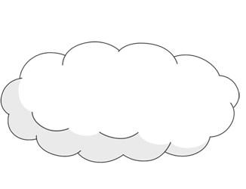
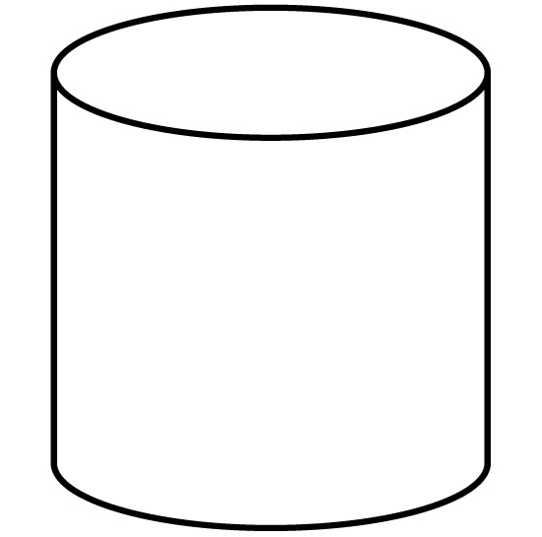


Cloud Based Genome Analysis
Can implement Inference Layer in workstation and use GQL to query Evidence Layer in cloud.
Can also implement Inference in Cloud and have apps use GQL/VCF to query cloud
Calling, Visualization
(IL)
Stored Genomes,
( EL)
Cancer Mutations?
Evidence?
SP3 Gene Deletion

Slide 26
GQL Table Schemas
Reads
location | strand | length | mate-location
Intervals
begin | end
User defined
attribute 1 | attribute 2

Slide 27
Idea 2: Make Intervals first class
Input: two interval tables (e.g. genes, Reads).
Output: Pairs of interval, one from each interval if and only if they intersect.
1,a
2,a
3,b
1
2
3
4
MapJoin
a
b
c
1
2
3
4
a
b
c

Slide 28
Merge Intervals
Given a collection of intervals, output merged representation of all intervals (e.g., for Deletions). Interval Union
Output
More GQL details: “Which way to Genomic Information Age”, CACM to appear, use Google
10/24/2012
28

Slide 29
Progress so far
Compression Layer:
  Tool Slimgene → Illumina pipeline
  40x compression without Quality Scores
GQL/EL Version 1.0:
  SNP style queries in less than 1 sec
  All discrepant READs in 160 minutes. Slow!
  Beyond SAMtools: GQL allows finding all Reads satisfying arbitrary predicate

Slide 30
GQL Deletion Script we ran
include<tables.txt>
genome NA18506;
Discordant = select * from READS
where location>=0 and mate_loc>=0 and
((mate_loc - location > 1000 and mate_loc –location < 2000000)
Select discordant reads
// Turn each mapping into an interval, marked by the end-point of the paired-end reads
Predicted_deletions =
select merge_intervals( interval_count > 5)
from Disc2Intrvl
Identify regions with coverage > 5
out= select *
from MAPJOIN Predicted_deletions, Discordant
using intervals(location, mate_loc)
Select Reads in these regions

Slide 31
Deletion Results
GQL found 113 deleted intervals on Chr. 1.
But Conrad et al. (Nat. Genet. 2006) used array hybridization to find only 8 deletions in Chr. 1 NA on same human.
Q: How do the two results compare?
Prior Results: Conrad et al
Begin | End
16887281 | 16896887
72537704 | 72585028
102599611 | 102603213
147303994 | 147313602
147373047 | 147395259
147373047 | 147395259
161154612 | 161166987
229387543 | 229391106

Slide 32
Probing further using GQL. . .
MapJoin with Conrad Intervals to find missing deletions (MD) in Conrad not in GQL Data
Select for discrepant Reads in MD. (None Found)
Concordant Reads within MD should have reduced count in MD. Selected Left and Right of MD and counted. (Did not find this effect)
NA18506 Is the child of a Yoruban trio. Repeated Query in parent. Deletions in GQL analysis not in Conrad’s data were in parent.
GQL allows interactive browsing of results

Slide 33
Implementation

Slide 34

Did you say millisecond access?

Slide 35
Indices, Algorithms
Location to Reads (SAMTools)
Predicate strength vectors
  Always true: Coverage
  Mate Pair Discrepancy: Deletions
Interval Trees, Lazy Joins
0 1 2 1 . . . . 1 2 3 2 . . .

Slide 36
Idea 3: Use Materialized views
AACAGCACA . . . . . . (Reference) . . . .
5
Mate
GCACA
Full View: 11 bits/base
88682
5
Mate
GCACA
Reduced: 3 bits/base
5
Mate
Minimal: 64b/Read
Hierarchy of files may make query plan easy

Slide 37
Views on “rows”
Coding regions
Given a query and a set of views and indices stored in files, generate optimal plan

Slide 38
Deletion Script Again
include<tables.txt>
genome NA18506;
Discordant = select * from READS
where location>=0 and mate_loc>=0 and
((mate_loc - location > 1000 and mate_loc –location < 2000000)
Minimal view only
Predicted_deletions =
select merge_intervals( interval_count > 5)
from Disc2Intrvl
out= select *
from MAPJOIN Predicted_deletions, Discordant
using intervals(location, mate_loc)
Reduced view only

Slide 39
Why materialized views help
Expensive genome wide scans only need minimal view. 100x smaller disk bandwidth
If only genes, another 100x smaller. Can cache smallest views in main memory and SSDs.
Yet increase in file storage at most 2x
DISK
Minimal
Gene
Full
Reduced
Minimal

Slide 40
Stir in, of course, parallel processing . .
Parallelize by chromosome or by slightly overlapping blocks (as in SciDB)
DSLs: Parallel processing with different backends: GPUs, Hadoop clusters . . .
Parallel patterns. One example: Interval trees used in Map Join
Joint work with V. Popov, O. Olokuton, S. Batzoglou

Slide 41
GQL could enable . .
Notes:
In order to explain the sample queries posed to a large system – biological hardware and computer system software -- for personalized medicine, let me start with a quick metaphor on some relevant aspects of genomics and in each case let the metaphor illustrate a few of the key processing queries that biologists and clinicians seem to be interested in

Slide 42
Idea 4: Use GQL for Group Inference
Strong Inference
Instead, lots of genomes + weak inference: high SNR
Like Google approach to spell checking:
large data + crude learning

Slide 43
Other Benefits
Provenance: Publish GQL scripts for reproducibility in all Genetics papers.
Crowdsourcing: Automatically divide up patients among users. Random SELECT
Privacy: notions akin to Differential Privacy & k-anonymity

Slide 44
Summary
Vision: Hypotheses generation in minutes not months: interactive genetics.
Ideas: Evidence layer, GQL interval operators, file views, group inference
Database: nothing new in itself but crucial to get whole package right
Applications: Cancer Genomics, Newborn genomics, personalized medicine, GWAS

Slide 45

So who will build the Genomic

Slide 46

Available on the market
Christos Kozanitis, who built GQL V1

Slide 47
Thanks
Lucila Ohno-Machado, who heads the iDASH project (NIH U54 HL108460), main funding.
Alin Deutsch, our database expert
Andrew Heiberg, who built the visualization tools that sit on top of GQL (not shown in this deck)
CALIT 2 (Larry Smarr, Ramesh Rao, Rajesh Gupta) for support & encouragement

Slide 48
Backup
Notes:
In order to explain the sample queries posed to a large system – biological hardware and computer system software -- for personalized medicine, let me start with a quick metaphor on some relevant aspects of genomics and in each case let the metaphor illustrate a few of the key processing queries that biologists and clinicians seem to be interested in

Slide 49
Why is GQL not SQL
Since Reads and Genes can be abstracted as intervals, intervals are first class entities.
As in SQL, Select is fundamental operator to select Reads satisfying predicate
Given intervals, it makes sense to use Joins based on interval intersection, not equality.
Find it also useful to “compress” intervals using an Interval Union operator
Have written most use cases using GQL (see paper) which gives us confidence

